Slide 2
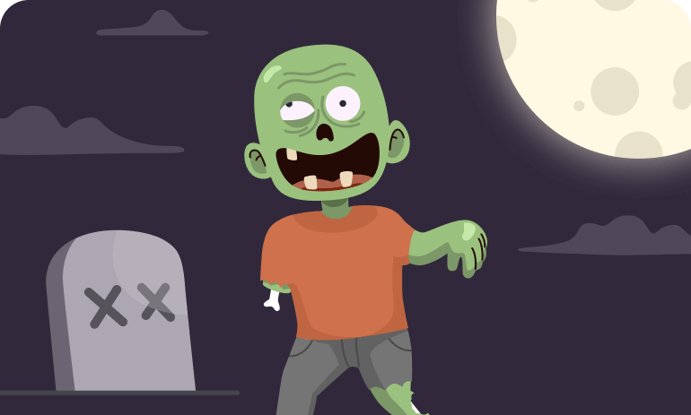
The Zombie Apocalypse

Slide 3
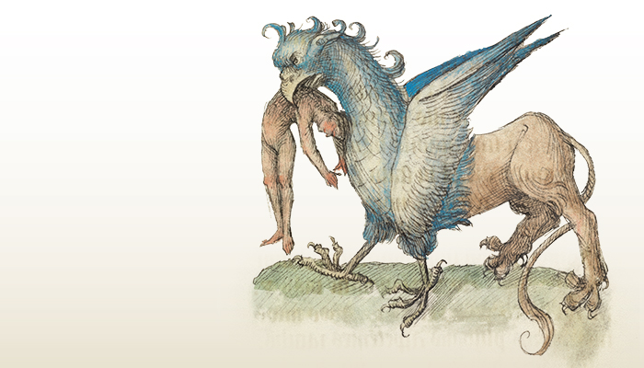
The Bestiary
Now is the moment to identify the enemies and challenges the team faced in the last Sprint. It’s important to be honest here! Problems cannot be improved if they are not first named.

Slide 4
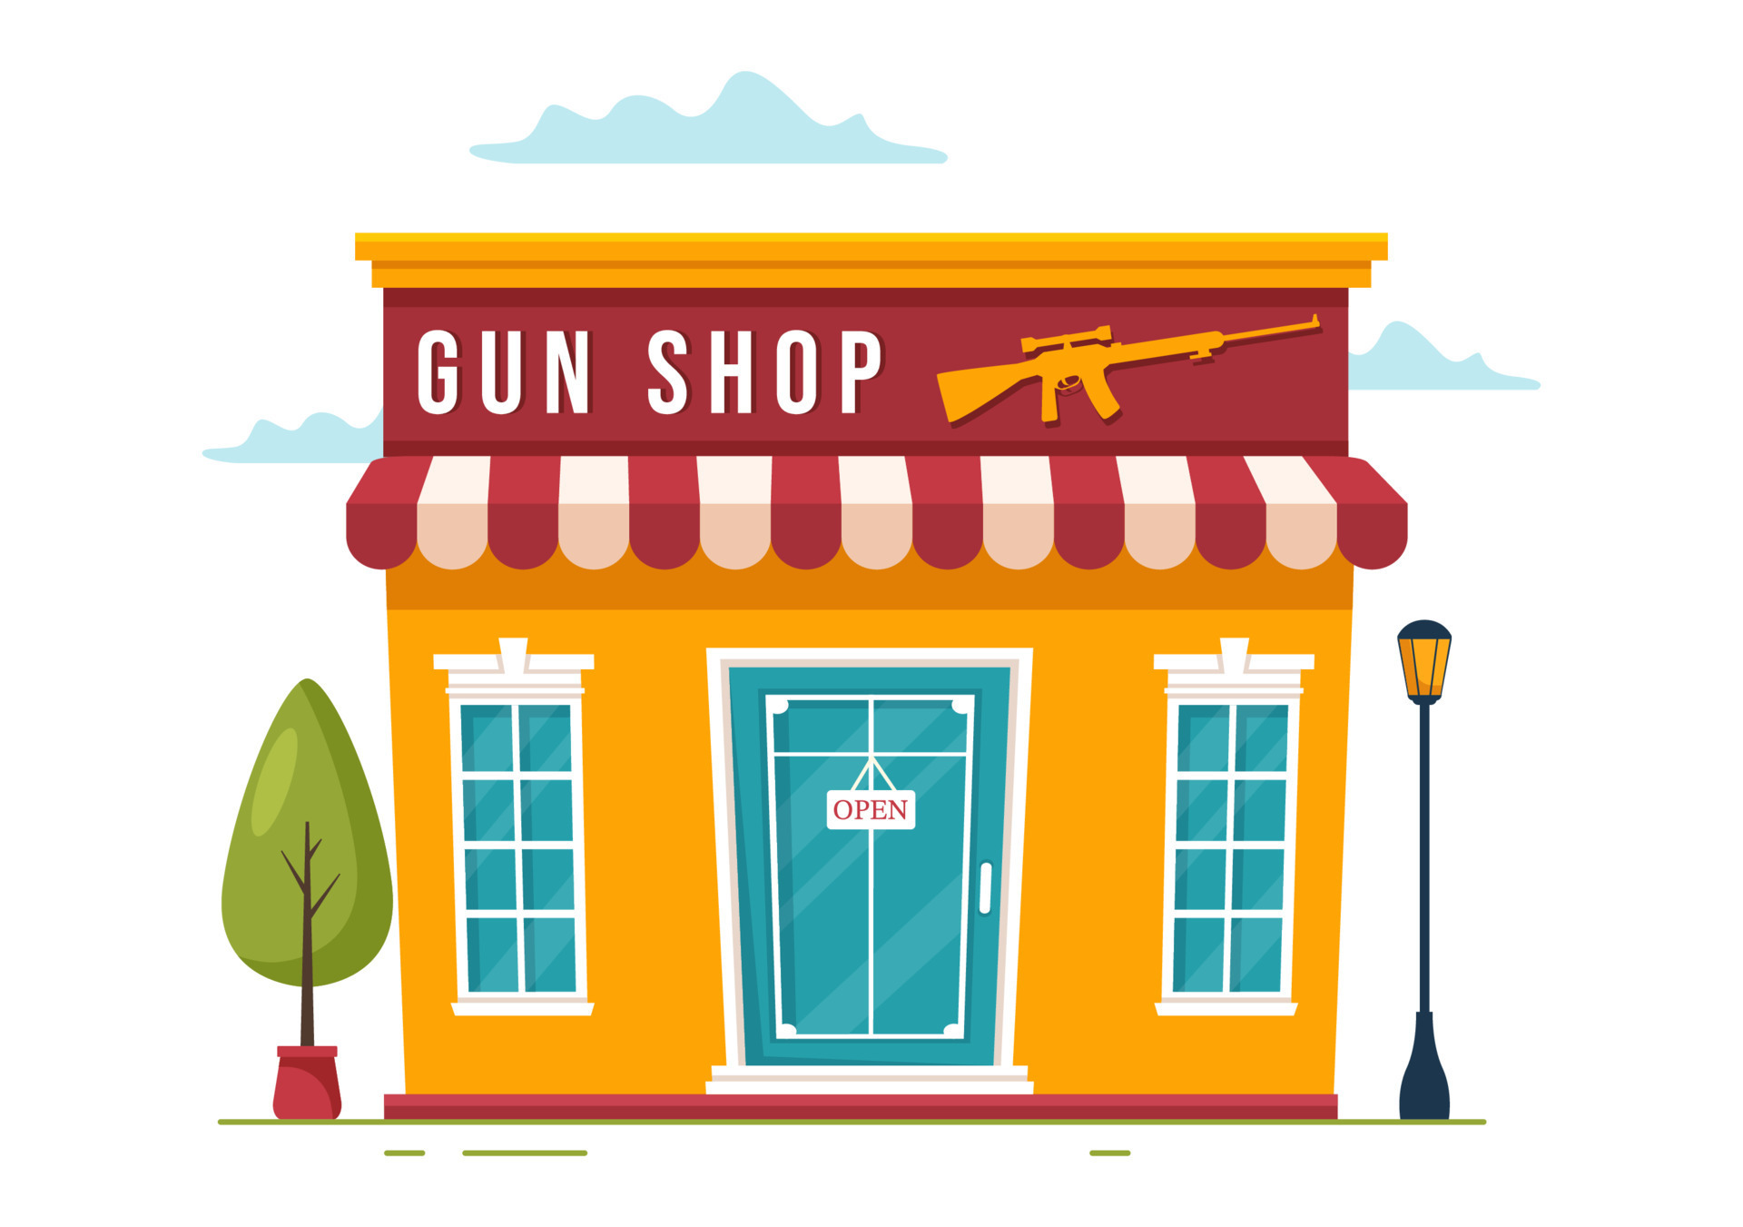
The Gun shop
Discuss the tools, techniques and processes that have proven to be useful for the team. Highlighting what works and what we want to continue to strengthen is as important as raising flags. Do we understand what is expected in terms of good practices?

Slide 5
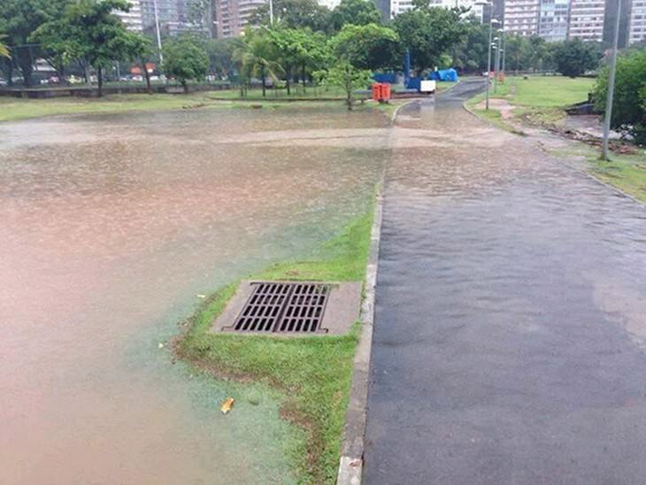
The perfect plan…or is it?
It’s time to chat about where and when things went wrong. What was the symptom? What was the cause? How did we solve it in the end? How could we have done it better?

Slide 6
The Survivors diary
What lessons have you learned from your adventures? Maybe you’ve noticed that a certain cross-team collaboration was helpful in getting the job done. Whatever it may be, take stock of lessons learned to build strength for the next Sprint.

Slide 7
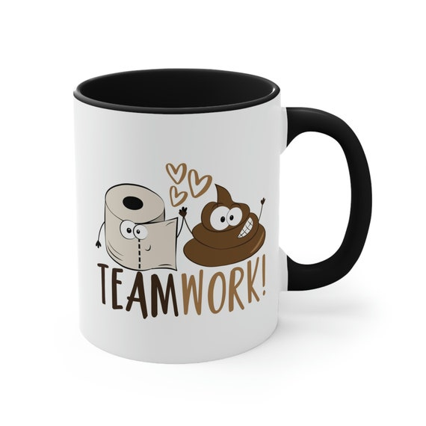
Unity is strength
How can we improve our team dynamics? Those Zombies are only as strong as our weakest team interaction. The better the trust, collaboration, and communication, the more the team can handle.

